Slide 1
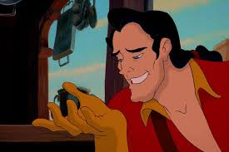
MANSPLAINING
AT MEETINGS
Cathy Carleton
@mktgmeetsit

Slide 2


As women begin to break through the glass ceiling…
…they find that having a seat at the table is not always the same as having a voice.
Mansplaining, Manterrupting and Bropriating
Let’s talk about what they are, and how we can change them.

Slide 3
“Wait –MANterrupting?
But don’t men interrupt other men, too?”
Yes.

Slide 4
“MANsplaining? Don’t women deliver unwanted explanations, too?”
Yes.
Sometimes like it’s our job.

Slide 5
“Aha! So is this REALLY a gender issue?”
Yes.
Because statistics.

Slide 6
Studies consistently show that men interrupt women almost 3 times as often than women interrupt men.
Men have the floor 75% of the time in meetings.
Less than 5% of Fortune 500 CEOs are women.
https://newrepublic.com/article/117757/gender-language-differences-women-get-interrupted-more
http://time.com/money/4450406/men-interrupt-talk-more/
http://fortune.com/2016/06/06/women-ceos-fortune-500-2016/

Slide 7
Mansplaining, Manterrupting and Bropriating
are gendered terms to describe gender-specific behavior that adversely affects women more than men.
https://newrepublic.com/article/117757/gender-language-differences-women-get-interrupted-more
http://time.com/money/4450406/men-interrupt-talk-more/
http://fortune.com/2016/06/06/women-ceos-fortune-500-2016/

Slide 8
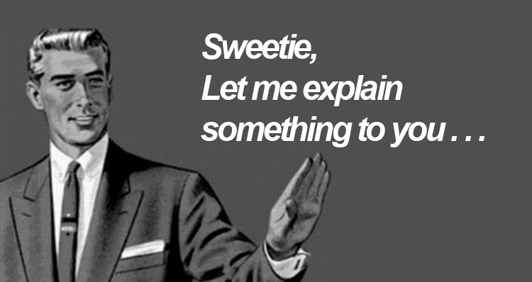
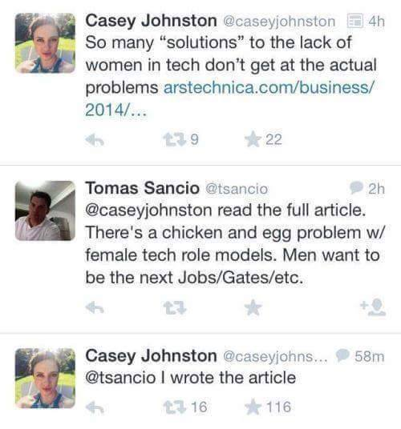
MANSPLAINING
WHAT IS IT?
A man providing a woman an unsolicited,
condescending explanation on a subject she already knows.
MANSPLAINING PREVENTION
Set ground rules for each meeting: Comments are welcome, but must present a new viewpoint or new information.
Be aware. Do you feel a need (or permission) to add explanations when a woman is speaking? Do others around you?
WHEN YOU ARE BEING MANSPLAINED TO
“I don’t need you to explain, Dirk.”
WHEN YOU WITNESS MANSPLAINING
Dirk, Rachel is the SME here.”

Slide 9
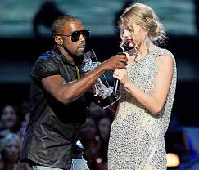
MANTERRUPTING (OR MANSTANDING)
WHAT IS IT?
A man talking over a woman’s speech or cutting her off in order to interject his own viewpoint
MANTERRUPTION PREVENTION
Set a general “no interruption” rule for all meeting participants, regardless of gender
Let participants know they will be called out when it happens
Imma let you finish, but...
WHEN YOU ARE BEING MANTERRUPTED
“Stop interrupting me, Kanye.”
WHEN YOU WITNESS MANTERRUPTION
“Hold up, Kanye - Taylor has the floor right now.”

Slide 10
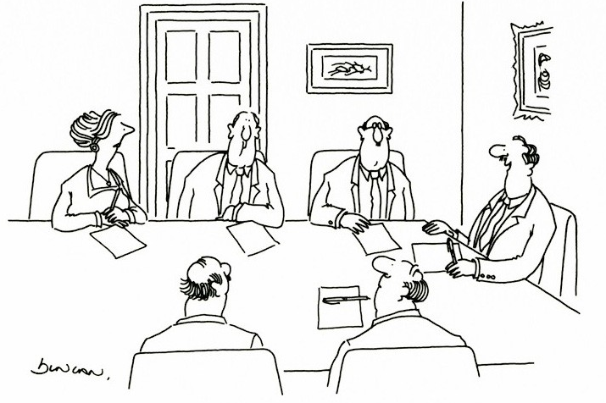
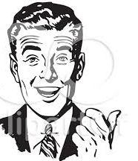
BROPRIATING
WHAT IS IT?
A man repeats or rephrases a woman’s idea,
and gets credit for it
BROPRIATING PREVENTION
Amplification – when a woman suggests an idea, repeat and attribute the idea by name.
“Mary’s idea is to relocate the conference to Oslo.”
This makes it harder for a dude to co-opt it later.
“That’s an excellent suggestion, Ms. Triggs – perhaps one of the men here would like to make it.”
“Your idea sounds so much better when I rephrase it.”
WHEN YOU ARE BEING BROPRIATED
“Yes, I just said that, Dirk.”
WHEN YOU WITNESS BROPRIATION
“Dirk, Mary just said that, and it appears you agree.”

Slide 11
Mansplaining, Manterrupting and Bropriating
They are not only a mute button on women’s voices. They are also a drag on creativity and productivity.
https://newrepublic.com/article/117757/gender-language-differences-women-get-interrupted-more
http://time.com/money/4450406/men-interrupt-talk-more/
http://fortune.com/2016/06/06/women-ceos-fortune-500-2016/

Slide 12
Don’t be a Dirk…be part of the solution!

